Slide 1
Bankruptcy Prediction
Project
Team Members:
Mrinal Rajkumar Saraswat
Sagaljyot Singh
Simran

Slide 2
About the Data
This data was found on Kaggle.com. It has information of different companies, their financial measures, and if they are bankrupt or not.
This is a large dataset with approx. 50,000 rows.

Slide 3
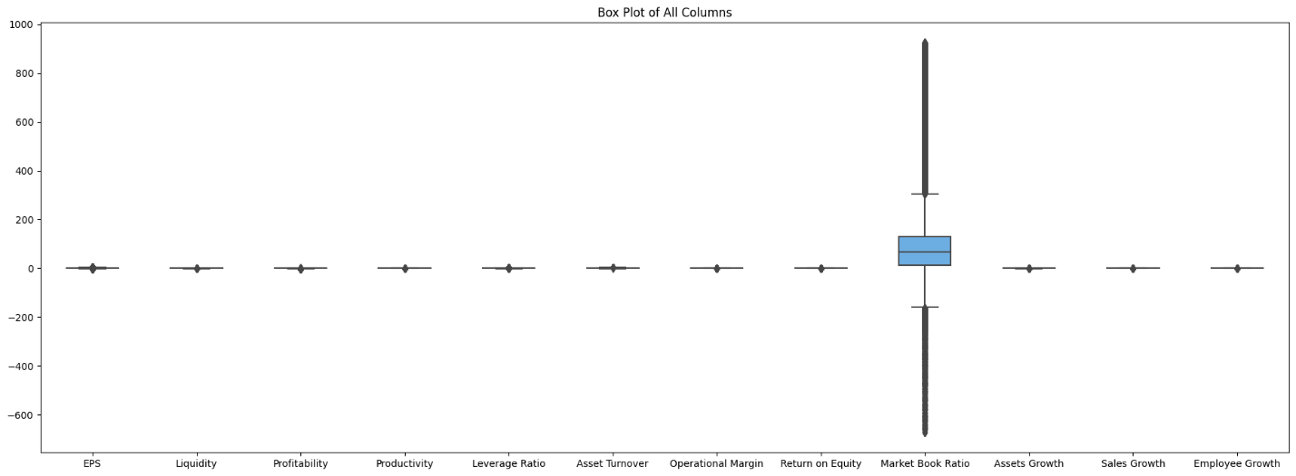
Exploratory Data analysis
Data had outliers.

Slide 4
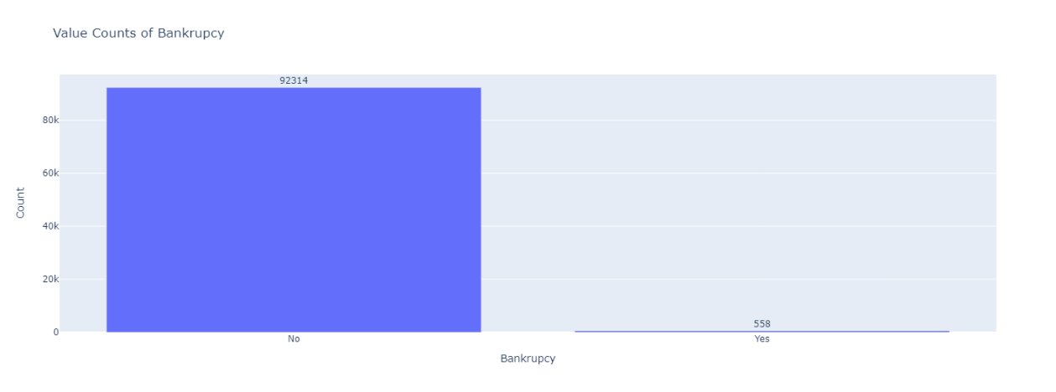
Exploratory Data analysis
Over-sampling of target variables:

Slide 5
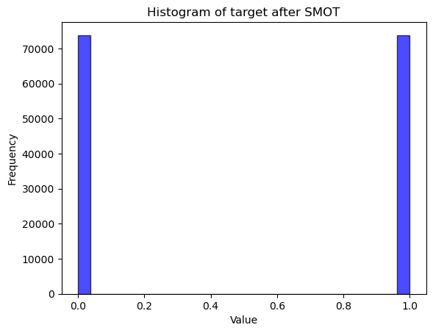
Exploratory Data analysis
Oversampling neutralised using Synthetic Minority Over-sampling Technique SMOTE

Slide 6
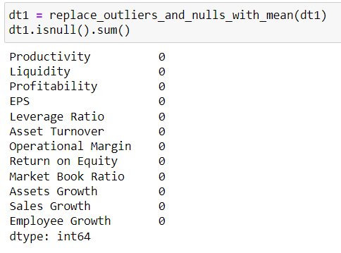
Exploratory Data analysis
Null values and extreme outliers were replaced by mean of their respective column

Slide 7
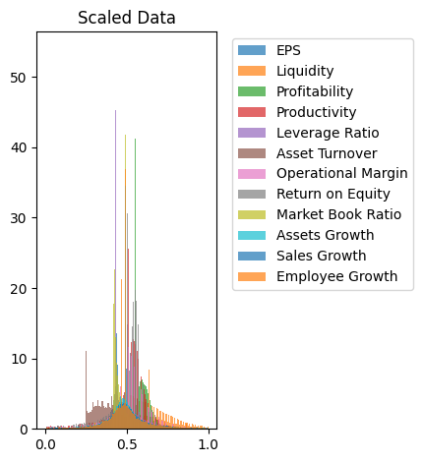
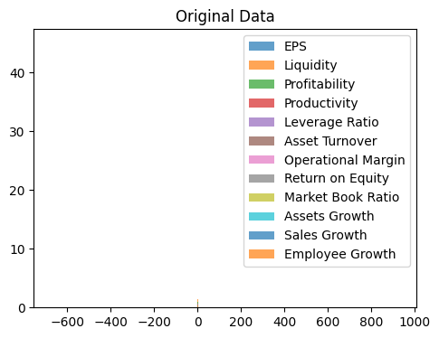
Exploratory Data analysis
Data scaled with Min-Max Scaler

Slide 8
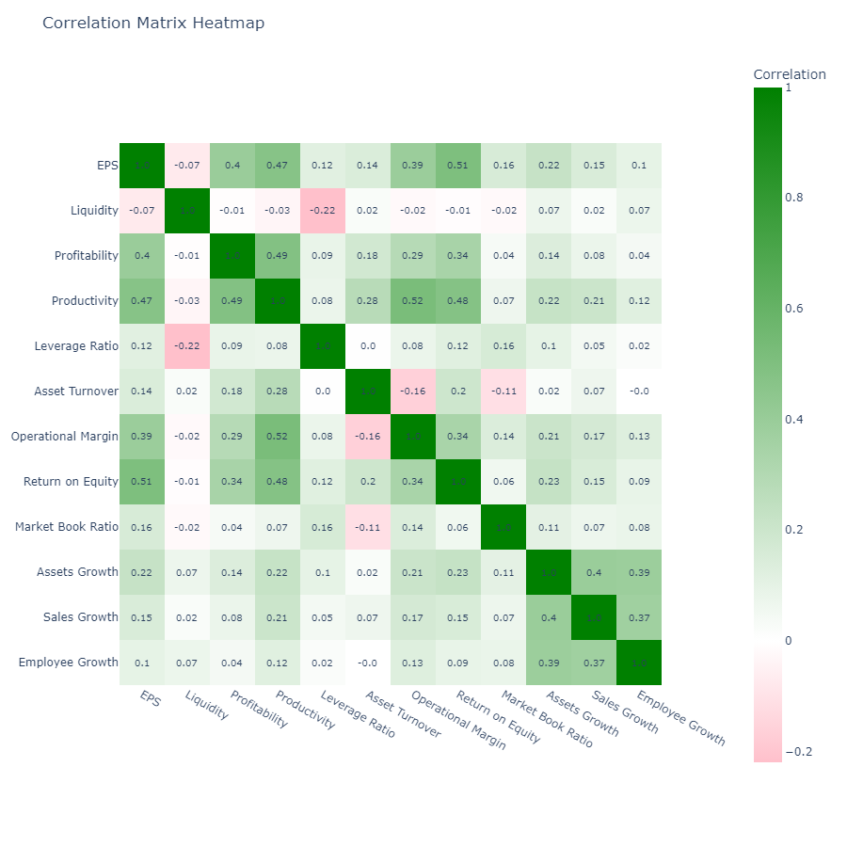
Principle component analysis
No large correlation between the variables.

Slide 9
Models used:
Logistic Regression
Support Vector Machine (SVM)
Decision Tree Classifier
Random Forest

Slide 10
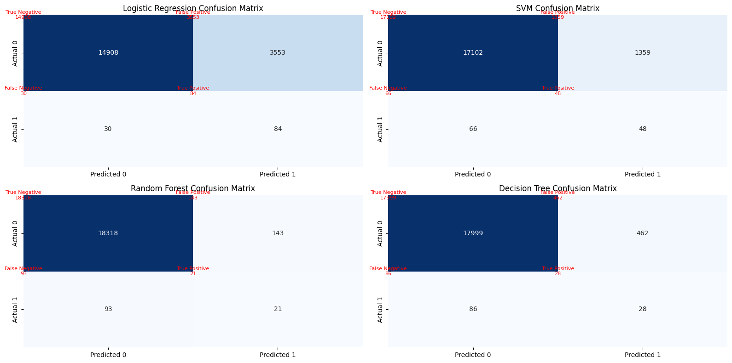
Confusion Matrix comparison

Slide 11
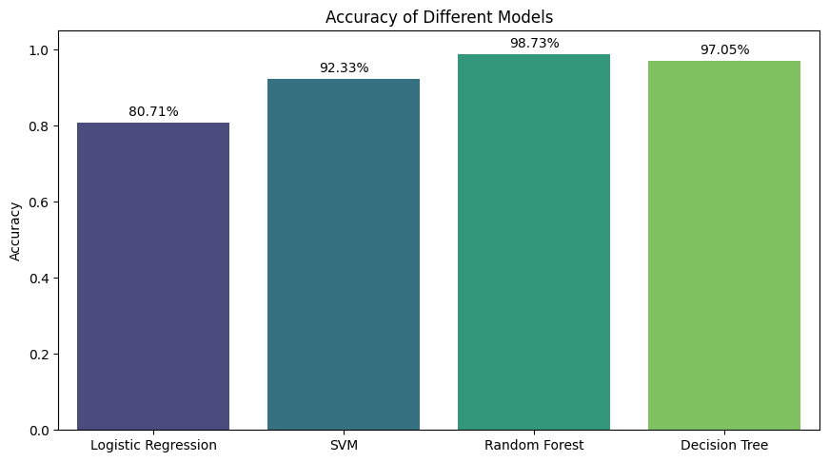
Model accuracy comparison

Slide 12
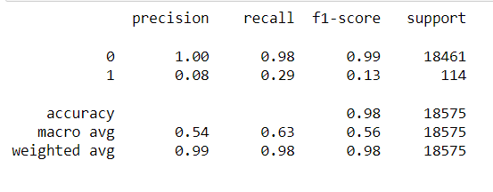
Random forest hyper-parameter tuning results

Slide 13
Thank you !!!

